Slide 1
Accessible Cooking with the Instant Pot Using Bluetooth and iPhone Apps
Presented By:
Bryan Garaventa – Accessibility Fellow &
Terri Fellers – Senior Director Services
CSUN 2018 Assistive Technology Conference
March 22, 2018
Notes:
#a11y is a widely used abbreviation for “accessibility”, and particularly accessibility of digital information, websites, apps, software and devices.

Slide 2
Overview
Accessible Cooking with the Instant Pot Using Bluetooth and iPhone Apps
Raffle rules
Let’s cook
iPhone Helper Apps
Instant Pot Smart60 Bluetooth Programmable Pressure Cooker
Recipe
Raffle time!
Let’s eat!
Notes:
In order to save time Bryan is going to get started cooking while I give the overview. We wanted to do something fun and different this year.
Last year at CSUN I was chatting with Bryan and telling him about my new Instant Pot and how much I loved it. I told him it was programmable. Bryan checked it out and discovered they had a Bluetooth version and ordered it for himself. He also fell in love and is now cooking for his family each week and inventing new recipes. It has given him the ability to cook safely and increase his independence in the kitchen.

Slide 3
Raffle Rules
Accessible Cooking with the Instant Pot Using Bluetooth and iPhone Apps
You must be present to win
Level Access helpers are walking around collecting business cards as entries for the raffle
If you do not have a business card, let one of them know, we have blanks that you can fill out. We can assist in filling them out if you need it
We’ll draw a name for the winner of the Smart60 Bluetooth cooker at the end of the presentation
If you are the winner we will get your address and ship the pot directly to you via FedEx.

Slide 4
Audit Helper Apps
Accessible Cooking with the Instant Pot Using Bluetooth and iPhone Apps
Seeing AI
A free app that narrates the world around you. Designed for the low-vision community, this research project harnesses the power of AI to describe people, text and objects
Bryan uses this app to scan barcodes on ingredients in his kitchen as he’s cooking

Slide 5


Instant Pot Smart60 Bluetooth Pressure Cooker
Accessible Cooking with the Instant Pot Using Bluetooth and iPhone Apps
Instant Pot Smart60 is a multi-functional fully-programmable Smartcooker combining the benefits of a Pressure Cooker, Slow Cooker, Rice Cooker, Porridge Maker, Steamer, Saute Pan, Yogurt Maker, Food Warmer and more.
Free iOS and Android app can be downloaded iTunes App Store and Google Play.
App allows the cooker’s functionalities to be expanded and recipe scripts can be shared with friends.

Slide 6
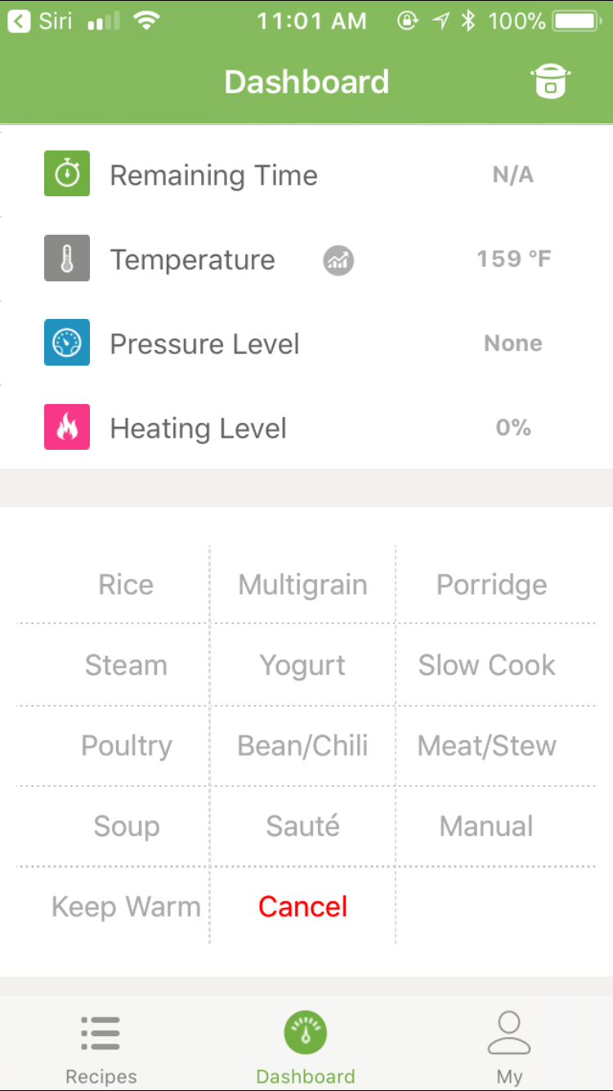
Instant Pot iOS App
Accessible Cooking with the Instant Pot Using Bluetooth and iPhone Apps
Works with the Smart60 cooker
Allows you to control and monitor the cooker wirelessly via Bluetooth connection
Comes with a collection of recipes
Timer functionality

Slide 7

Portuguese Beer Chicken: Ingredients
Accessible Cooking with the Instant Pot Using Bluetooth and iPhone Apps
2 teaspoons Olive Oil
3.5 lbs. boneless skinless chicken pieces
1 lb. fresh chopped portabella mushrooms Hint: easy to chop using hardboiled egg slicer
1 large carrot, chopped
2 large onions, chopped
2 12 ounce cans of dark beer
1 tablespoon Salt
1 packet of French Onion Soup Mix
Optional hot pepper sauce

Slide 8

Portuguese Beer Chicken: Instructions
Accessible Cooking with the Instant Pot Using Bluetooth and iPhone Apps
Add olive oil to pot, turn on Sauté setting, wait for snap crackle and pop
Add onions, stir periodically for approximately 5 minutes to caramelize.
Add carrots to the pot stir periodically for a couple more minutes.
Add layer of raw chicken over the onions and carrots.
Add layer of sliced mushrooms over the chicken.
Add beer. This should cover over the top of the mushrooms.
Optional hot pepper sauce, salsa or siracha to taste. Three tablespoons added to beer in pot for our recipe
Add 1 tablespoon of salt to beer in pot (can be adjusted to your preferences)
Cancel Sauté setting.
Put lid on and close valve for pressure cooking
Select Meat and Stew or Manual Setting on High pressure for 20 minutes.
Quick release the pressure and serve.

Slide 9
Winner Winner Chicken Dinner
Accessible Cooking with the Instant Pot Using Bluetooth and iPhone Apps
Last chance to get your entries in!
And the winner is………..

Slide 10
Let’s Eat!
Accessible Cooking with the Instant Pot Using Bluetooth and iPhone Apps
Samples will be provided at the back of the room if you’d like to try Bryan’s recipe
Allergy warning: Chicken, onions, beer, carrots, mushrooms, hot sauce.

Slide 11
Questions?

Slide 12






Thank You/ Resources
Accessible Cooking with the Instant Pot Using Bluetooth and iPhone Apps
Contact Us
Follow Us
Bryan Garaventa
Bryan.Garaventa@LevelAccess.com
@LevelAccessA11y
Level-Access
Terri Fellers
Terri.Fellers@LevelAccess.com
Level Access
Level Access Blog
Slide Deck Available for Download at: https://www.levelaccess.com/csun18/

